Slide 1
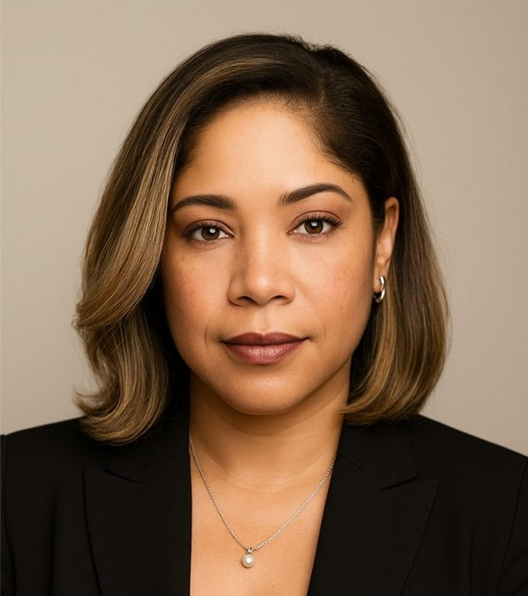

#NSN 2025
BRAG BOOK
Kai Sanders
M. Ed., AE-C
www.MsSanders.com

Slide 2
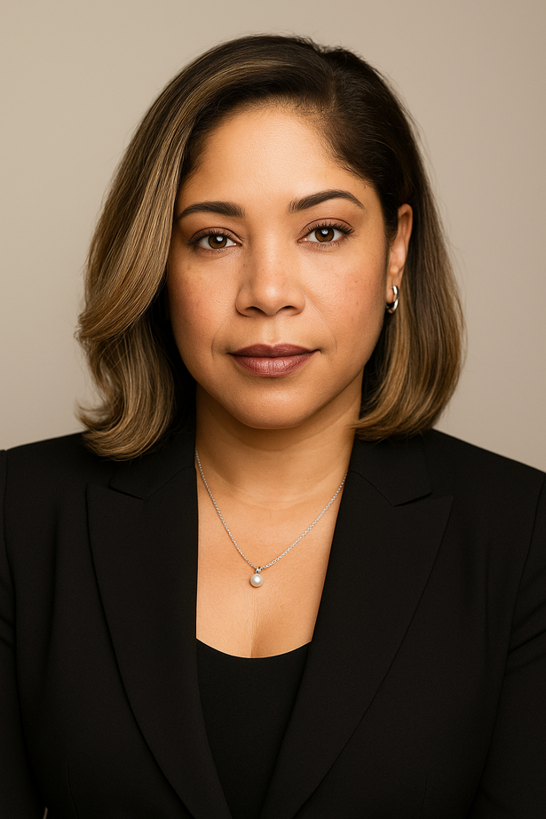
Welcome!
MEET MS. SANDERS
Dynamic and engaging healthcare educator and trainer with deep expertise in clinical education , medication compliance counseling, and patient engagement. With a strong foundation in the medical, pharmacy, and healthcare industries, I bring over a decade of experience using persuasive communication and motivational interviewing to support behavior change and improve health outcomes..
Whether I’m training clinical teams, speaking to patients, or collaborating across departments, I bring clarity, compassion, and strategy to every interaction.
With a strong foundation in chronic disease education, particularly asthma and autoimmune conditions . . .
“I’m now focused on bringing that expertise into pharmaceutical sales or training—especially in respiratory or neurology-focused roles—where I can make a broader impact.”
www.MsSanders.com

Slide 3

Table of Contents
04..……………………………………………….……….……………………….…………….Introduction
05 - 6.…………………………………………….…………………………..…………………….Highlights
07..……………………………………………….……..…………..…………………Skills and Expertise
08..………………………………………………….…..………….Professional Impact Statement
09..………………………………………………………………..…..….……………………….Persuasion
10..………………………………………………..…………………..………….Physician Re-Training
11..…………………………………………………………………….…………………….Patient Centric
12..…………………………………………………………...…………….RX Compliance Increased
13..……………………………………………………………………..……………………………...Passion
14- 15.……………………………………………………………………………………………………L.O.R.
16..…………………………………………………………..….……….……….Cultural Competency
18 …………………………………………………………..………………………………. Patient centric
19 ………………………………………………………………………………………………………….Kudos
20……………………………………………………..……………………Behavioral Health Training
21……………………………………………………….……………………………………. MCO Training
22………………………………………………………….....................................................MVP
23 ……………………………………………………….……………………..I Should be YOUR MVP
www.MsSanders.com

Slide 4

INTRODUCTION
Welcome to my Brag Book
Certified Asthma Educator AE-C, with experience in Asthma/Allergy education and chronic disease management
Passionate about reducing disease disparities through patient advocacy and outreach
Collaboration with Specialty Clinics
A. LTA, Life Threatening Asthma
B. Sickle Cell/ Asthma
C. Cystic Fibrosis
Skilled in: Relationship Management & Rapport Building, Healthcare Operations & Systems and community-based interventions
" PATIENTS ARE EITHER UNDERMEDICATED, UNDERTREATED AND/OR UNDEREDUCATED"
www.MsSanders.com

Slide 5


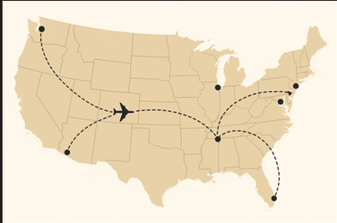
HIGHLIGHTS
Public Speaking
Biogen- Brand Ambassador/ Public Speaker for Neurosciences -
Presenting at Patient Empowerment Programs
Delivered high-impact patient education programs for those living with chronic conditions, focusing on medication adherence
Recognized for attaining high presentation and engagement scores that advance, best practices, pharmaceuticals, and medical devices
Promoted awareness of Biogen’s product portfolio through patient-centered storytelling and engagement.
Clinical Education
A. Texas School Nurses over 500 in virtual attendance
B. Texas Children’s Hospital Sleep Disorders Lab
C. Outpatient Pediatric Clinics
D. Respiratory Therapists
E. Service Coordinators/ Case Managers
F. Complex Case & Disease Management
www.MsSanders.com

Slide 6
HIGHLIGHTS
Clinical Education
CONT’D.
I. Baylor Pediatric Skills Resident Rotation implemented and supported inter-professional learning
A. Provided comprehensive learning experience in asthma management
B. Taught residents how to provide comprehensive asthma counseling to families
1. ensured residents could create tailored asthma action plans
2. proper inhaler techniques and device delivery age- appropriateness selection
SME
Trainings Facilitated
IDEA, 504 , ARD meetings and ADA policy
ECI Services, and school advocacy
Culturally competent healthcare
Autism- Early detection, Identifying resources, Classroom & Community Supports
Understanding Neurodivergence- ADHD “Wired Differently,
Systems Training for New Hires- Using Patient Navigators, My Chart, EPIC, Healthy Planet Tapestry, SharePoint.
HIPPA mandates, Documentation integrity, and state & federal compliance with Medicaid Managed Care programs- CHIP, STARKids, STAR Plus eligibility. Transition Services, MDPC
SMART goal setting - wellness goals and Diabetes Management
www.MsSanders.com

Slide 7
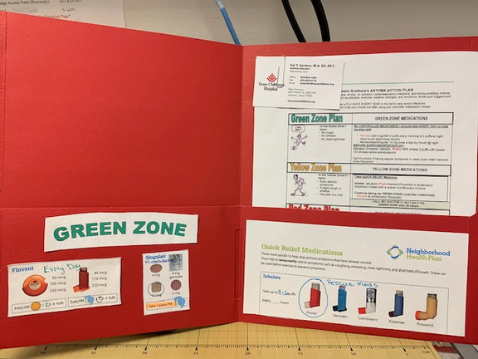
SKILLS AND EXPERTISE
Systems Training/
EPIC
EPIC Live Implementation
and support for Patient Education documents
EPIC transition- facilitated EMER transition into electronic format to support system wide implementation of asthma action plans amongst a large integrated hospital delivery system supporting Inpatient and outpatient populations
Revised and updated patient Education Materials for an integrated hospital delivery system
Consulted on multiple Asthma Action Plan Updates to support the EPIC Integration
www.MsSanders.com

Slide 8
PROFESSIONAL IMPACT STATEMENT
I bring energy, clarity, and enthusiasm to every session, making even complex or routine topics engaging and accessible for all learners. I have a strong understanding of teaching pedagogy, adaptive facilitation and capable of influencing others.
I specialize in designing and delivering impactful training—both in-person and virtual—that equips professionals with practical tools for success. Known for my ability to build rapport across diverse populations and teams, I’m passionate about translating complex medical concepts into clear, actionable guidance that drives results!
I have the uncanny ability to connect with even the most resistant of clients and facilitate understanding which prompts desired behavior changes.
Strong Motivational Interviewing skills and use of effective persuasion…
SKILLS:
Adaptive Facilitation, Training , Instructional design, LMS, motivational interviewing, Learning & Development needs analysis, chronic disease management, Onboarding, Program Development, Rx Compliancy Training/ Injectable Therapies
Healthcare Expertise
Navigating complex systems (e.g., Medicaid, Managed Care Organizations, chronic disease programs)
Strong Understanding regulatory frameworks and workflows
Championed the development, marketing, and launch of programs to meet emerging patient and compliance needs
Persistent, Persuasive, Patient
Personable & Patient Centric
www.MsSanders.com

Slide 9
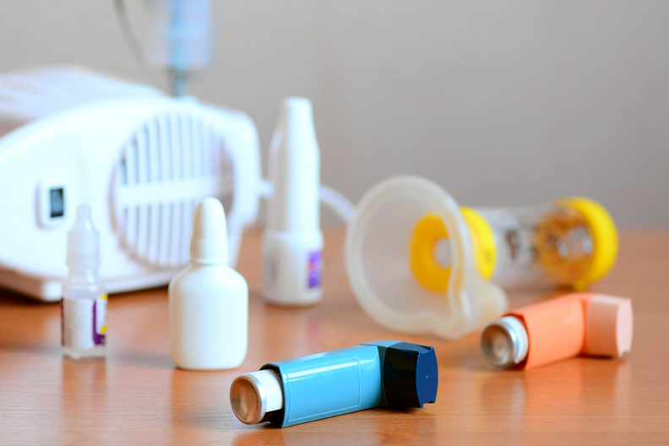
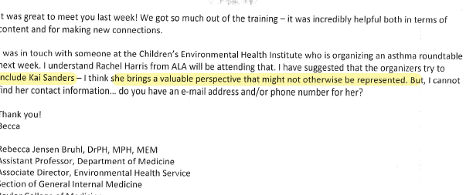
PERSUASION
Medication compliance is at the heart of what I do!
Most chronic illnesses can be managed optimally, by using therapeutic agents consistently.
“I make an impact with tactics of persuasion to convince patients to use medications appropriately- IE. Biologics, inhaled corticosteroids, antihistamines” etc..
www.MsSanders.com

Slide 10
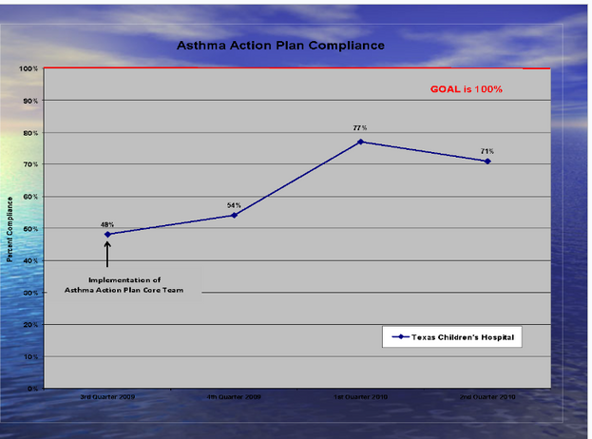

SUCCESSFULL PHYSICIAN RE-TRAINING, LED TO 60% IMPROVEMENT IN COMPLIANCE SCORES
Poorly written action plans were dropping our Joint Comm. compliance rates to less than 50%
The Ideas
Result: 90% MD’s were more cognizant of their action plans, and began writing them within guidelines.
Our compliance rates increased to 90-97% and scores remained consistent.
www.MsSanders.com

Slide 11
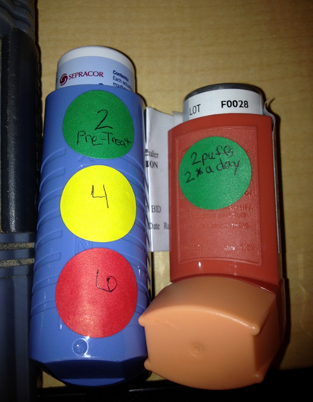
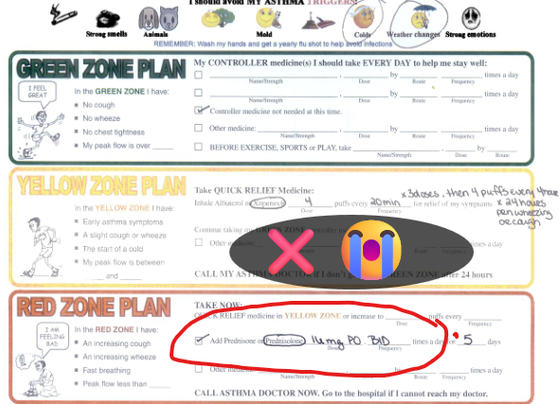
PATIENT CENTRIC
Persistent!
I Used color coded dots to place directly on canisters for easy identification and proper titration of dose as correlated with their Asthma Action Plans.
Labeling Rx at bedside, resulted in successful patient interactions, resulting in better compliancy, and supporting patient’s independence and self advocacy.
Medication instructions misinterpreted--The patient assumed these were mailing instructions for a Post Office Box...
www.MsSanders.com

Slide 12
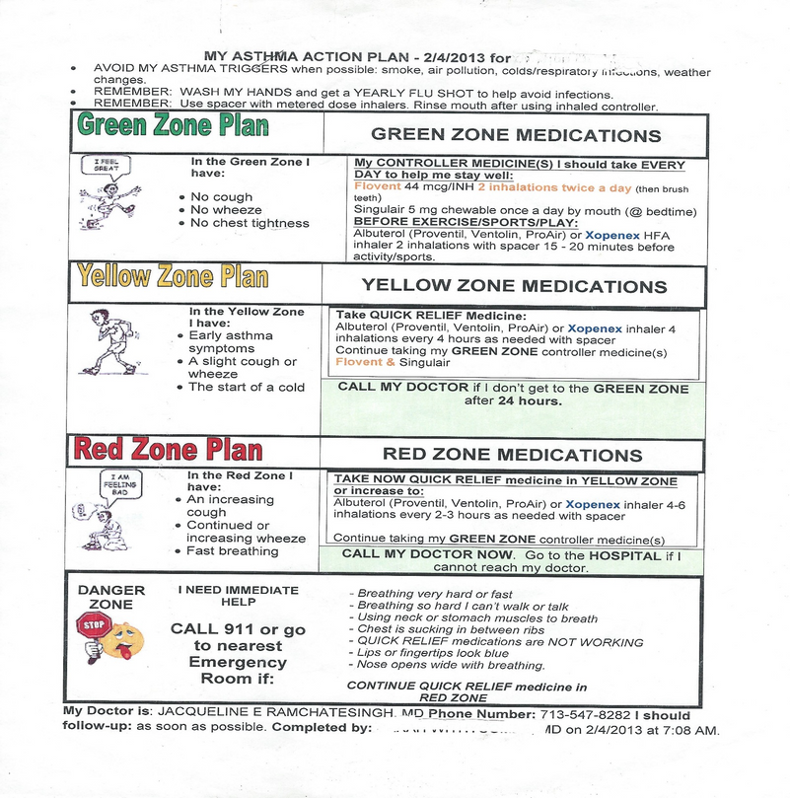
Rx Compliance Increased
Complicated jargon makes following home management plans challenging.
I methodically coordinated pt.'s action plans to correlate with the colors of their MDI cannisters.
Included Pt’s Allergy Rx as Green Zone
Assessing for EIA to include Pre-treats of SABA
Provided tailored consults & color copies for teaching @ discharge
Analytical thinking collaboration adaptability
www.MsSanders.com

Slide 13
Passion
ASTHMA BURDEN OF IMPACT
My dedication to providing patient centric care which is both personable and acutely tailored to one’s needs, has had a measurable impact on reducing the asthma care burden in the community.
I have overcome some of the most objectionable- educated and less-educated individuals to comply with best practice guidelines for disease management.
ACCOMPLISHMENTS
Developed Standardized care procedure in conjunction with Emergency Medicine Physician which positively increased the # of patients leaving the ED with an Asthma Action Plan and medication Training Leading, to over 92%of patients were being discharged from the hospital with compliantly written asthma action plans.
Increased Ped Res satisfaction scores consistently in the high 4’s and frequently cited their experience in Asthma Pedi Skills Rotations with the Asthma Educator as one of their favorite parts of their rotation.
Provided training and shadowing opportunity for Hospital Pharmacist to provide medication device demonstrations and best clinical practice for administration and route
Contributed to being named an Asthma Center of Excellence by Joint Commission
Devised a Quarterly Newsletter: Eazing the Wheezing, shared with Hospital Unit staff and Residents.
Success of Pedi Skills Rotation, presented at multiple local and nat’l educational forums including Baylor Educational Innovations, Baylor Educational Showcase, Young Investigators Forum in Respiratory Diseases and the American Thoracic Society conf
www.MsSanders.com

Slide 14
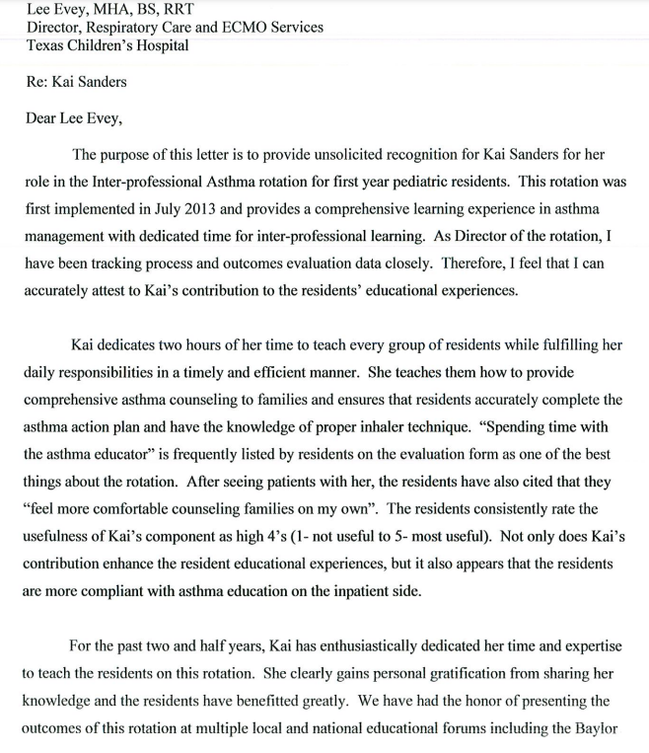
Letter of Recommendation
www.MsSanders.com

Slide 15
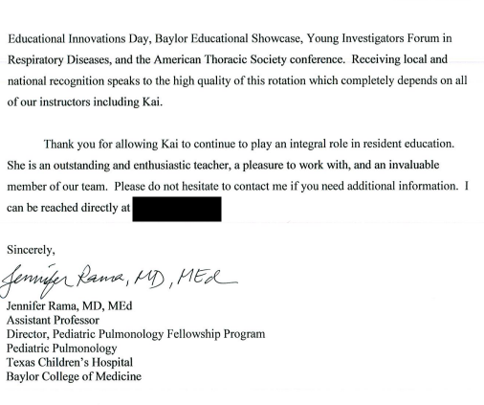
www.MsSanders.com

Slide 16
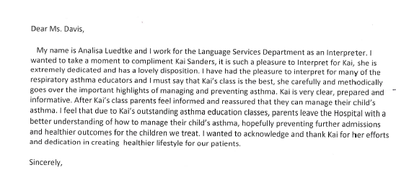
Cultural
Competency
I take pride in communicating with families in their native language when possible. I find value in such authentic interactions, and systematized hospital protocols to ensure families were discharged with language appropriate information / instructions
Advocated to EMR/ EPIC applications team to include Spanish versions of patients' home management plan and retrained hospital residents on the importance and responsibility of such
Participated in weekly Spanish Class -
" Patients are either Undermedicated, undertreated and/or undereducated"
www.MsSanders.com

Slide 17
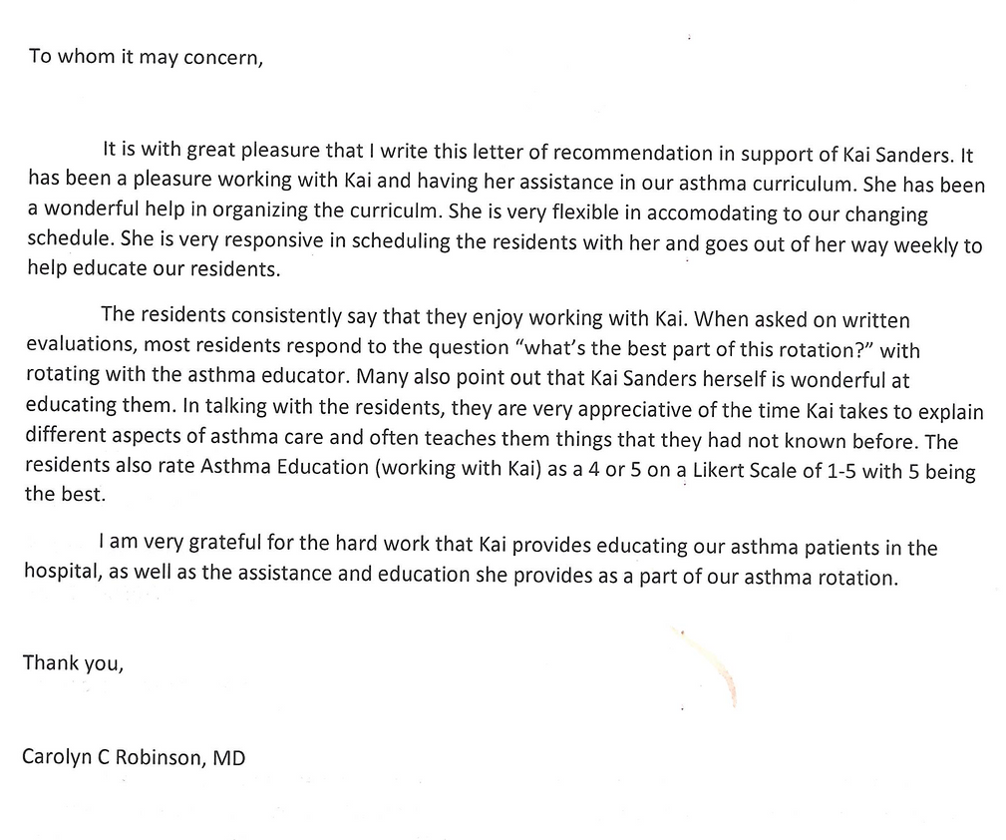
RELATIONSHIP MANAGEMENT
I’m patient enough to know that not all will “Buy in”- at first presentation.
*Non-Compliance to therapies ALSO builds repeat business
www.MsSanders.com

Slide 18
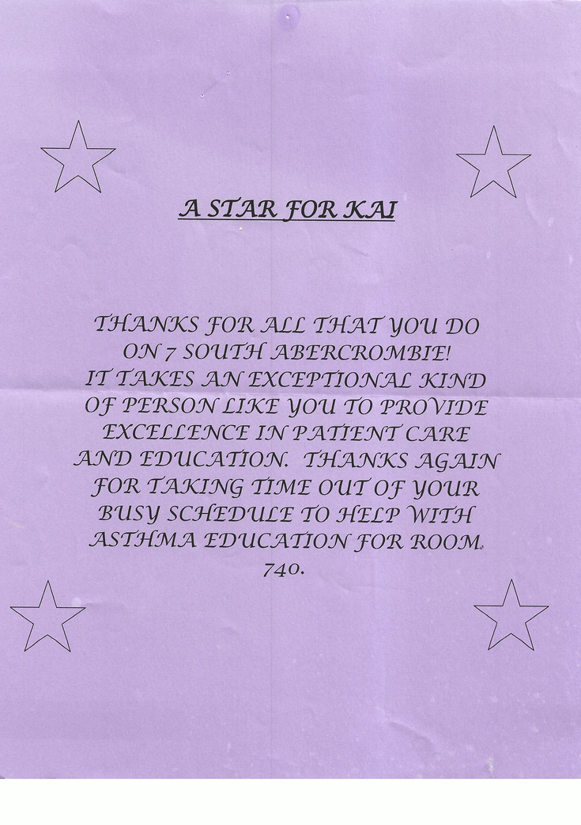
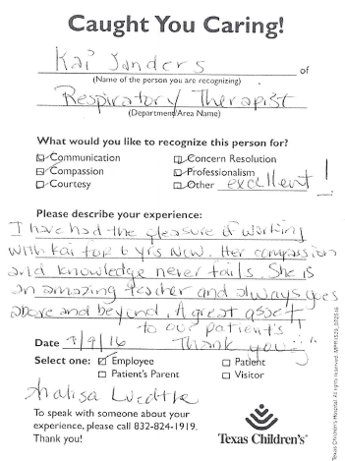
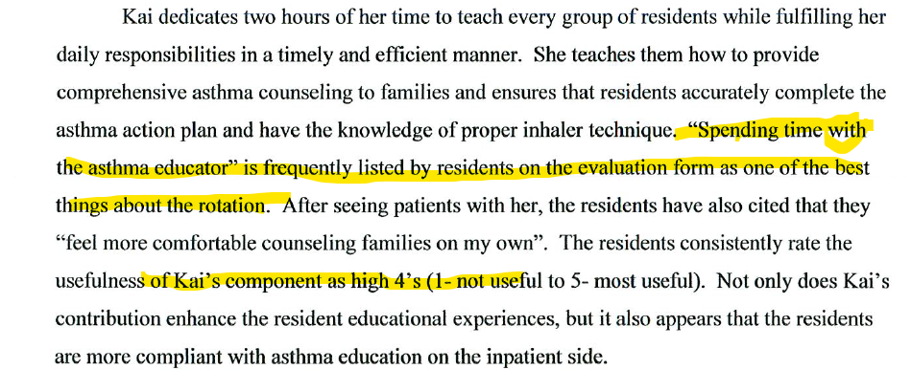
Patient Centric
www.MsSanders.com

Slide 19
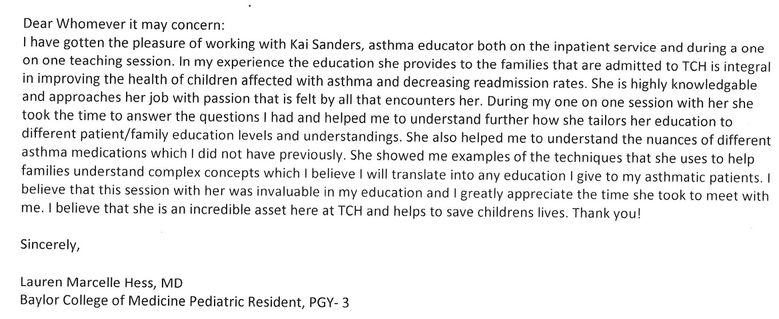
KUDOS
Work with me....
How my colleagues would describe me:
. Engaging Creative CLEVER VERSATILE
, Knowledgeable Compassionate Exceptional
Poised professional Adaptable Witty Inspirational
www.MsSanders.com

Slide 20
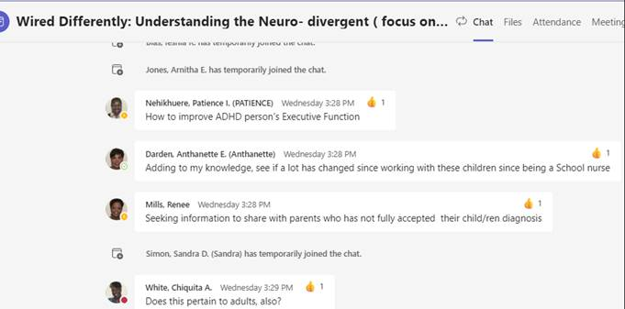
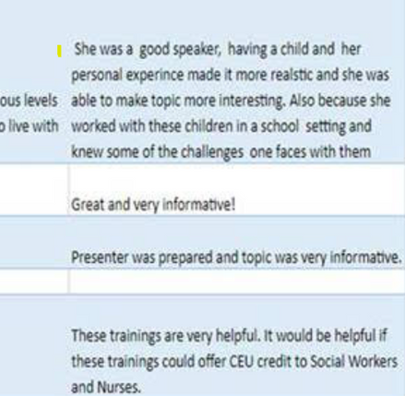
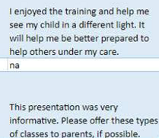
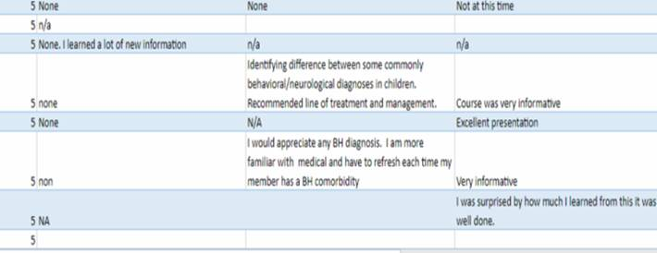
BEHAVIORAL HEALTH TRAINING
My trainings ( optional/ Professional Development) had more than 3 times the number in attendance as my colleagues, and maintained satisfaction ratings in high 9o%.
www.MsSanders.com

Slide 21
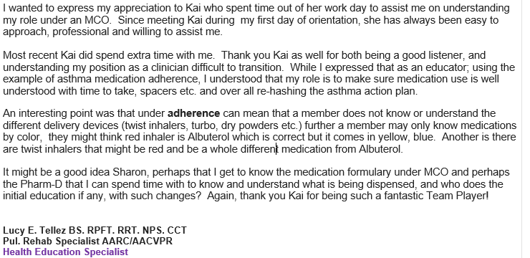
MCO Staff Development
Accomplishments
CHANGE INITIATIVES / CROSSFUNCTIONAL COLLABORATION
Reduced and streamlined onboarding & training length
Devised Virtual Triggers assessment and asthma management program FRC’s were successful and patients engaged well
Retained over 95% of newly integrated team members while improving overall performance.
Program Development - Worked with Marketing to have a wellness program approved advertised for Health Plan members’ participation in 8 week courses designed to support healthy eating habits and provide virtual fitness training and healthy recipes, while demonstrating how to shop on a budget.
Resulted in Over 40 % participants reduced their BMI by 4-6%
www.MsSanders.com

Slide 22
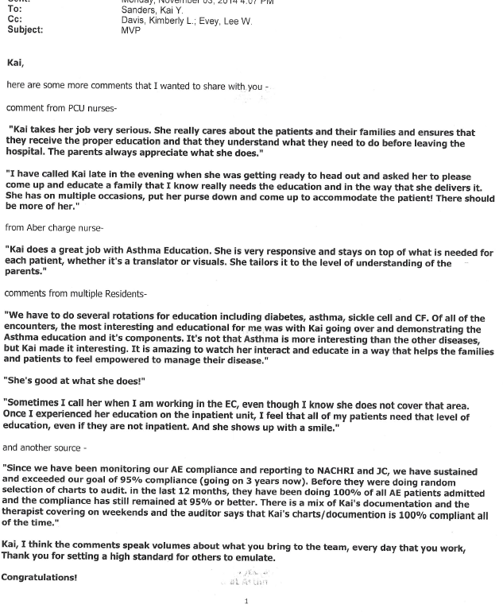
MVP
RESPIRATORY DEPT.
www.MsSanders.com

Slide 23
WHY I SHOULD BE YOUR
MVP !
I am highly coachable, self- reflective and competitive!
My in-depth clinical knowledge and public speaking expertise
I’m passionate about translating complex medical concepts into clear, actionable guidance that drives results.
I have a clear commitment to health equity, chronic disease management, and improving outcomes, particularly in asthma and autoimmune conditions.
Both my personal & professional Knowledge of the medical, healthcare /pharmacy industry keep me heavily invested- not just informed!
I have trained providers on the use of inhalers, nebulizers, and biologic therapies for pediatric asthma patients, including discharge protocol development.
Experienced presenting asthma management best practices to clinical teams, supporting behavioral change and product adoption.
I have created education materials referencing national respiratory standards (e.g., NHLBI, GINA, FDA).
My ability to communicate relevant healthcare data cogently and effectively builds trust.
I am capable of making quick connections with clinicians & patients and will represent your brand with clarity warmth and professionalism.
Kai Sanders
M. Ed., AE-C
www.MsSanders.com

Slide 24


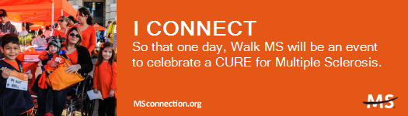
VOLUNTEERING & COMMUNITY ENGAGEMENT
NBRC Asthma Exam Specialty Committee
Kid’s Lonestar MS Kids Camp Counselor
MS Charity Walks & MS 150 volunteer
Cystic Fibrosis Fight for Air Climb
National Asthma Networking Group
High school UIL Speech & Debate Judge
www.MsSanders.com

Slide 25
Persistent, Persuasive, Patient
Personable & Patient Centric
MOST OF ALL- I CAN INFLUENCE BEHAVIOR CHANGE, THAT LEADS TO HEALTHY OUTCOMES.
Kai Sanders
M. Ed., AE-C
www.MsSanders.com

